Slide 1
Types of Machine Learning
TIET, Patiala

Slide 2
Types of Machine Learning
Machine Learning can be classified broadly into three types:
Supervised Learning
Unsupervised Learning
Reinforcement Learning
The above mentioned methods can be combined in different ways and hence we have some hybrid learning problems :
Semi-supervised Learning
Self-supervised Learning
Multi-Instance Learning

Slide 3
Supervised Learning
Supervised Learning occurs when an algorithm learns from examples data and associated target responses (which can be numeric values or string labels).
Supervised learning is where we have input variables (x) and an output variable (Y) and use an algorithm to learn the mapping function from the input to the output Y = f(x) .
The goal is to approximate the mapping function so well that when you have new input data (x) that you can predict the output variables (Y) for that data.
It is similar to human learning under the supervision of a teacher.
The teacher provides good examples for the student to memorize, and the student then derives general rules from these specific examples.

Slide 4
Supervised Learning Problems
In Machine Learning, we deal with two types of supervised learning problems:
Classification:
Classification models are trained to classify data into categories.
The categories are discrete in nature (such as yes/no, 0/1, small/medium/large, etc.)
Binary Classification has two class labels where as a Multilabel classification has more than two labels.
Regression:
In regression problems, the input variables are mapped to a continuous function.
In other words, we try to predict result within a continuous output.

Slide 5
Supervised Learning Problems Contd….
Example:
Credit Scoring: Given information of customers income, savings, age, profession, past financial history.
Classification: Predict whether a new customer is at low-risk or at high-risk in returning the credit.
Regression: Predict what is the probability that a new customer is at high-risk or low-risk.

Slide 6
Examples-Supervised Learning Problems
Classification:
Customer Retention
Fraud Detection
Image Classification
Image Segmentation
Medical Diagnosis
Anomaly Detection
Handwriting Recognition /OCR
Text Classification
Email Classification
Sentiment Analysis
Opinion Mining
Text Summarization
Regression:
Population Growth Prediction
Estimating Life Expectancy
Market Forecasting (Stock Market, Bit Coin)
Credit Policing
Weather Forecasting
Advertising Popularity Prediction/ New Insights
House Price Prediction
Process Optimization

Slide 7
Classification Algorithms
Bayesian
Naïve Bayes
Gaussian Naïve Bayes
Decision Tree
Classification and Regression Tree (CART)
Iterative Dichotomiser 3 (ID3)
Instance-Based
K-Nearest Neighbor
Learning Vector Quantization (LVQ)
Multinomial Naïve Bayes
Bayesian Belief Networks
Bayesian Network
C4.5
C5.0
M5
Conditional Decision Tree
Decision Stump
Self-Organizing Map (SOM)
Locally Weighted Learning (LWL)
Kernel-Based
Support Vector Machines
Polynomial Kernel
Gaussian Kernel
Sigmoid
Linear
Non Linear
Hyperbolic
Neural Network –Based
Deep Neural Network
Artificial Neural Network
Convolutional Neural Networks (CNN)
Logistic Regression
Recurrent Neural Networks (RNN)
Miscellaneous
Random Forest

Slide 8
Regression Algorithms
Regression
Least Square Regression
Linear Regression
Multivariate Adaptive Regression Splines (MARS)
Locally Estimated Scatterplot Smoothing (LOESS)
Logistic Regression
Stepwise Regression

Slide 9
Unsupervised Learning
Unsupervised Learning occurs when an algorithm learns from plain examples without any associated response.
These type of algorithms determine the data patterns on its own and restructures the data into something else such as new features that may represent a class or new series of uncorrelated values.
The goal of unsupervised learning is to discover patterns from data.
As unlabeled data is more abundant than labeled data, machine learning methods that facilitate unsupervised learning are more valuable.

Slide 10
Unsupervised Learning Problems
Unsupervised Learning methods are used in the following three types of problems:
Clustering
Learning Associations
Dimensionality Reduction

Slide 11
Clustering
Clustering is the task of dividing the population or data points into a number of groups such that data points in the same groups are more similar to other data points in the same group than those in other groups.
In simple words, the aim is to segregate groups with similar traits and assign them into clusters.

Slide 12
Clustering Examples
Clustering algorithms are widely used in a number of applications such as:
Market Segmentation / Targeted Marketing / Recommender Systems
Document / News / Article Clustering
Biology / Genome Clustering
City Planning
Speech Recognition
Social Network Analysis
Organize Computing Clusters
Astronomical Data Analysis

Slide 13
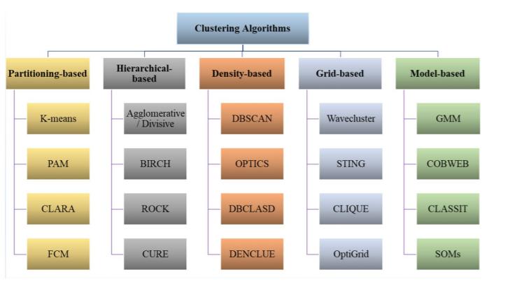
Clustering Algorithms

Slide 14
Learning Associations
Association rule learning is a type of unsupervised learning technique that checks for the dependency of one data item on another data item and maps accordingly so that it can be more profitable.
It tries to find some interesting relations or associations among the variables of dataset.
It is based on different rules to discover the interesting relations between variables in the database.
It is employed in Market Basket analysis, Web usage mining, continuous production, medical diagnosis, protein sequencing, catalog design, etc.

Slide 15
Learning Association Algorithms
Following three algorithms are used for learning associations:
Apriori Algorithm
FP Growth Algorithm
EClaT (Equivalence Class Transformation) Algorithm.

Slide 16
Dimensionality Reduction
Large number of dimensions in the feature space can dramatically impact the performance of machine learning algorithms, generally referred to as the “curse of dimensionality.”
Therefore, it is often desirable to reduce the number of input features.
Dimensionality reduction, or dimension reduction, is the transformation of data from a high-dimensional space into a low-dimensional space so that the low-dimensional representation retains some meaningful properties of the original data.
Dimensionality Reduction is employed in a number of applications such as Structure Discovery, Big Data Visualization, noise reduction, signal processing, speech recognition.

Slide 17
Dimensionality Reduction Algorithms
Feature Selection
Filter Strategy
Wrapper Strategy
Feature Projection
Principle Component Analysis (PCA)
Embedded Strategy
Linear Discriminant Analysis (LDA)
Auto Encoders
t-SNE
UMAP
Single Valued Decomposition (SVD)

Slide 18
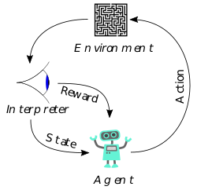
Reinforcement Learning
Reinforcement learning (RL) is an area of machine learning concerned with how intelligent agents ought to take actions in an environment in order to maximize the notion of cumulative reward.

Slide 19
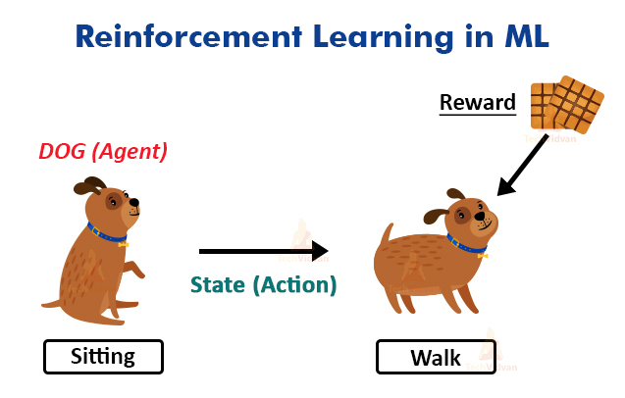
Reinforcement Learning
Let’s say we have a dog and we are trying to train your dog to sit.
We would give certain instructions to the dog to try to make it learn.
If the dog executes the instruction perfectly, it would get a biscuit as a reward. If not, it would not get anything.
The dog learns from this after some tries that it would get a biscuit if it sits.

Slide 20
Reinforcement Learning Algorithms
Reinforcement learning is studied in many disciplines, such as game theory, control theory, operations research, information theory, simulation-based optimization, multi-agent systems, swarm intelligence, and statistics.
The major algorithms for reinforcement learning includes Q-learning, Model-Based learning (Value Iteration, Policy Iteration), and Temporal Difference Learning

Slide 21
Semi-Supervised Learning
This is a combination of supervised and unsupervised learning.
This method helps to reduce the shortcomings of both the above learning methods.
In supervised learning, labelling of data is manual work and is very costly as data is huge. In unsupervised learning, the areas of application are very limited.
To reduce these problems, semi-supervised learning is used.

Slide 22
Semi-Supervised Learning Contd…
In this, the model first trains under unsupervised learning. This ensures that most of the unlabeled data divide into clusters.
For the remaining unlabeled data, the generation of labels takes place and classification carries with ease.
This technique is very useful in areas like speech recognition and analysis, protein classification, text classification, etc.

Slide 23
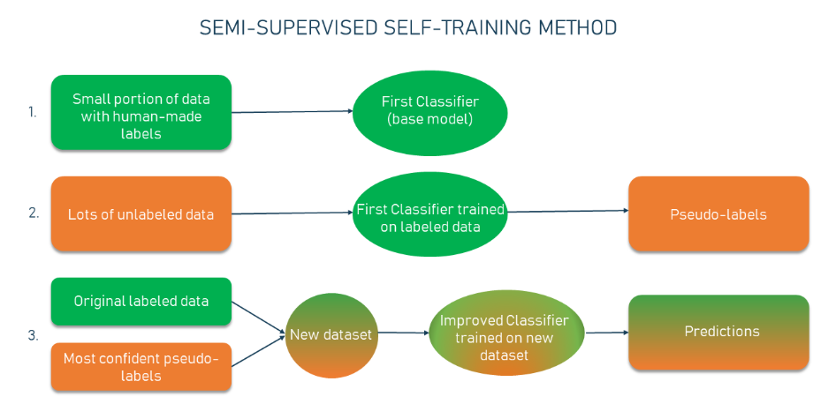

Slide 24
Self-Supervised Learning
It is a more advanced version of unsupervised learning which requires supervisory data along with it.
Only in this case, the labelling of the data is not done by humans.
The model itself extracts and labels the data. It does so with the help of the embedded metadata as supervisory data.
A common example of self-supervised learning is computer vision where a corpus of unlabeled images is available and can be used to train a supervised model, such as identify the same image with different rotations.
A general example of self-supervised learning algorithms are autoencoders and Generative Adversial Networks (GANs)

Slide 25
Multi-Instance Learning
Multiple Instance Learning or MIL is another variation of supervised learning. Here, the training data isn’t labelled individually, it is nicely arranged in bags.
An arranged set of training data is called bags and the entire bag is labelled. This is a weaker but an interesting form of supervised learning method.
If one entity is fitted with the result, it’s entire bag is given positive. But if it does not fit, the entire bag equates to negative.
The goal of this method is to classify unseen bags based on labelled bags.

Slide 26
Recent Trends in ML Learning
Multi-Task Learning
A type of supervised learning that involves fitting a model on one dataset that addresses multiple related problems.
Applications: Word Embeddings, Spam Filtering, Web Searching
Ensemble Learning
Ensemble learning is an approach where two or more modes are fit on the same data and the predictions from each model are combined.
Transfer Learning
Is a type of learning where a model is first trained on one task, then some or all of the model is used as the starting point for a related task.
Applications in NLP and Image Classification

